Slide 1
Concepts in ASP.NET Core App
#03#
Design by: TEDU
Trainer: Bach Ngoc Toan
Website: www.tedu.com.vn
Facebook: fb.com/teduchannel
Please like videos and subscribe TEDU Channel to following the next video.

Slide 2
Contents
Fundamentals
Startup
Services
Middleware
Servers
Content root
Web root
Configuration
Environments
.NET Core vs. .NET Framework runtime

Slide 3
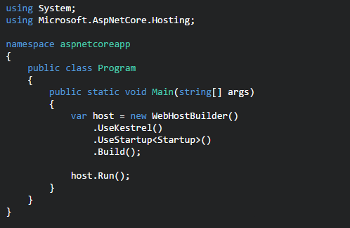
Fundamentals
An ASP.NET Core app is simply a console app that creates a web server in its Main method:
Notes:
Main uses WebHostBuilder, which follows the builder pattern, to create a web application host. The builder has methods that define the web server (for example UseKestrel) and the startup class (UseStartup). In the example above, the Kestrel web server is used, but other web servers can be specified. We'll show more about UseStartup in the next section. WebHostBuilder provides many optional methods, including UseIISIntegration for hosting in IIS and IIS Express, and UseContentRoot for specifying the root content directory. The Build and Run methods build the IWebHost object that will host the app and start it listening for incoming HTTP requests.

Slide 4
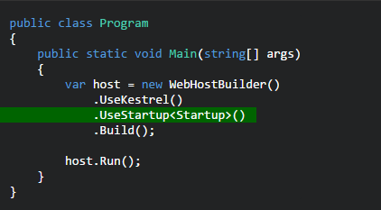
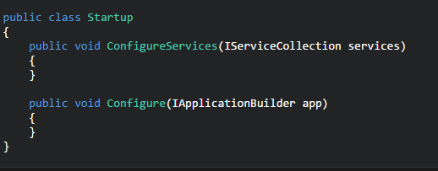
Startup
The UseStartup method on WebHostBuilder specifies the Startup class for your app.

Slide 5
Services
A service is a component that is intended for common consumption in an application.
Services are made available through dependency injection (DI).
ASP.NET Core includes a simple built-in inversion of control (IoC) container that supports constructor injection by default.
The built-in container can be easily replaced with your container of choice.

Slide 6
Middleware
ASP.NET Core middleware performs asynchronous logic on an HttpContext and then either invokes the next middleware in the sequence or terminates the request directly.
You generally "Use" middleware by taking a dependency on a NuGet package and invoking a corresponding UseXYZ extension method on the IApplicationBuilder in the Configure m
ASP.NET Core comes with a rich set of built-in middleware:
Static files
Routing
Authentication

Slide 7
Servers
The ASP.NET Core hosting model does not directly listen for requests; rather it relies on an HTTP server implementation to forward the request to the application.
The forwarded request is wrapped as a set of feature interfaces that the application then composes into an HttpContext.
ASP.NET Core includes a managed cross-platform web server, called Kestrel that you would typically run behind a production web server like IIS or nginx.

Slide 8
Content root
The content root is the base path to any content used by the app, such as its views and web content.
By default the content root is the same as application base path for the executable hosting the app; an alternative location can be specified with WebHostBuilder.

Slide 9
Web root
The web root of your app is the directory in your project for public, static resources like css, js, and image files.
The static files middleware will only serve files from the web root directory (and sub-directories) by default.
The web root path defaults to /wwwroot, but you can specify a different location using the WebHostBuilder.

Slide 10
Configuration
ASP.NET Core uses a new configuration model for handling simple name-value pairs. The new configuration model is not based on System.
Configuration or web.config; rather, it pulls from an ordered set of configuration providers.
The built-in configuration providers support a variety of file formats (XML, JSON, INI) and environment variables to enable environment-based configuration.
You can also write your own custom configuration providers.

Slide 11
Environments
Environments, like "Development" and "Production", are a first-class notion in ASP.NET Core and can be set using environment variables.
For more information, see Working with Multiple Environments.

Slide 12
When to choose .NET Core
You have cross-platform needs.
You are targeting microservices.
You are using Docker containers.
You need high performance and scalable systems.
You need side by side of .NET versions by application.

